Slide 1
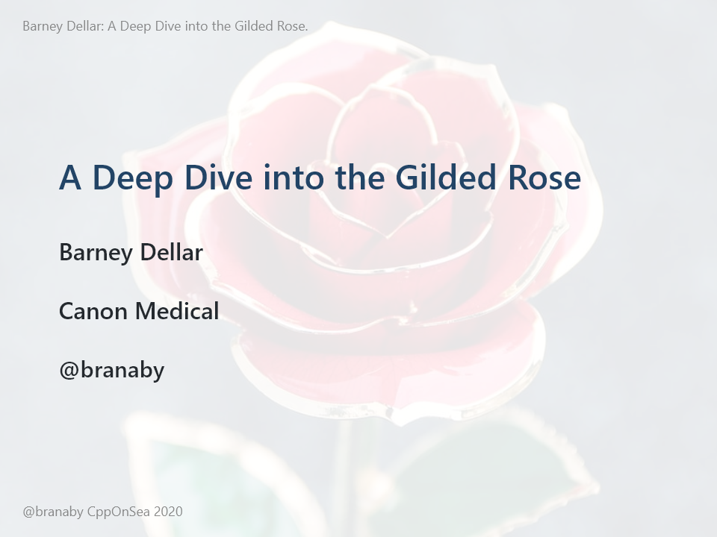
Notes:
Hi there. I'm Barney Dellar. I'm a Software Team Lead at Canon Medical in Edinburgh. I'm going to talk to you today about deliberate practice, improving your skills using katas, tooling, testing, and continuous learning.
Please ask any questions in the Q&A and I’ll try and answer them as I go.

Slide 2

Notes:
A couple of years ago I had the great pleasure of bringing Amitai Schleier in to my work for a week. Amitai's a technical Agile coach, and it was great to have him on my team for a few days. One thing he really pushed was the idea of a Learning Hour. Every day, do some deliberate practice. Practicing your skills is very common in lots of fields. People go out jogging, or do yoga, Musicians regularly practice sample pieces or scales. Martial artists perform set pieces called katas. But for some reason, it's not so common in software.

Slide 3

Notes:
In Japanese, the word "kata" is used to describe a martial-arts practice that is regular, repetitive, and choreographed. And in software, we love to borrow words from Japanese. So exercises for practicing the art of writing software are also know as katas. Although because software is complex and changing, our practices tend to be less regular and less repetitive. There is a good collection of katas on-line if you want to look for them.

Slide 4
Notes:
So on my team, we started doing regular katas. We did these using mob programming, which is a practice we use a lot in general. Talk to me later if you're interested in that! In these learning sessions, we practiced Test Driven Development, we tried various katas, and we had a go at learning other languages such as Haskell. And we didn't just do this because it's fun. Although learning together IS fun! We did it to become better at what we do. To make our every-day work a bit easier, to go that bit faster...

Slide 5
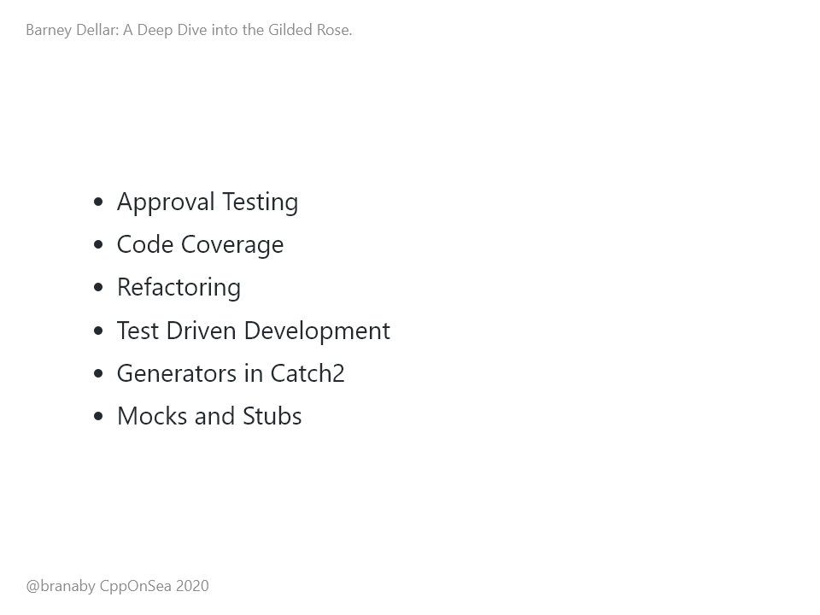
Notes:
And I'm going to talk to you now about one kata in particular that we spent a lot of time on. Some katas can be done in half an hour or less. But we spent weeks on one in particular, and we learnt some interesting things along the way. I'm going to share some of that with you now. I'm going to talk about the kata in general, how we got to grips with it using Approval Testing and code coverage tools, how we refactored, how we added new unit tests, some cool things we learnt about generators in Catch2, and finally a look at Mocks and Stubs.

Slide 6
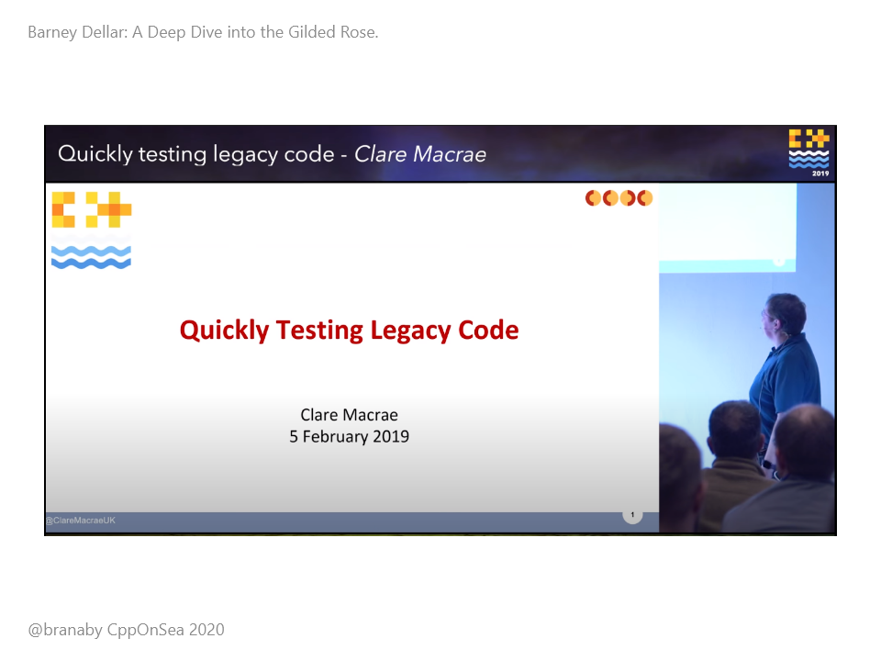
Notes:
OK, I'm going to back up a bit first. I went to Clare Macrae's excellent talk last year at CppOnSea, on quickly testing legacy code. She talked about the Approval Test library, which she helped port to C++. And I thought it would be great to try and practice with this library. I work on a lot of legacy code, so I'm always keen to try out new tools and practices that can help me. So I looked for a kata that we could try as way of exploring the Approval Test library. But as we explored this kata, we ended up going much further than just using Approval Testing. And that's what I'm going to talk to you about today.

Slide 7

Notes:
Right. This kata, that we spent so long on, is called the Gilded Rose. Most katas start from nothing. You have an empty project, and you have to implement some tricky function or other. These can be great for practicing specific skills. But they're not representative of how we normally work. The Gilded Rose is different. This kata is designed to mimic a real legacy codebase. You're given a readme, some code, including one class that you can modify, and some unit tests. The kata was originally created by Terry Hughes in C#. And since then, Emily Bache has gone on to translate it into more than 40 languages.

Slide 8
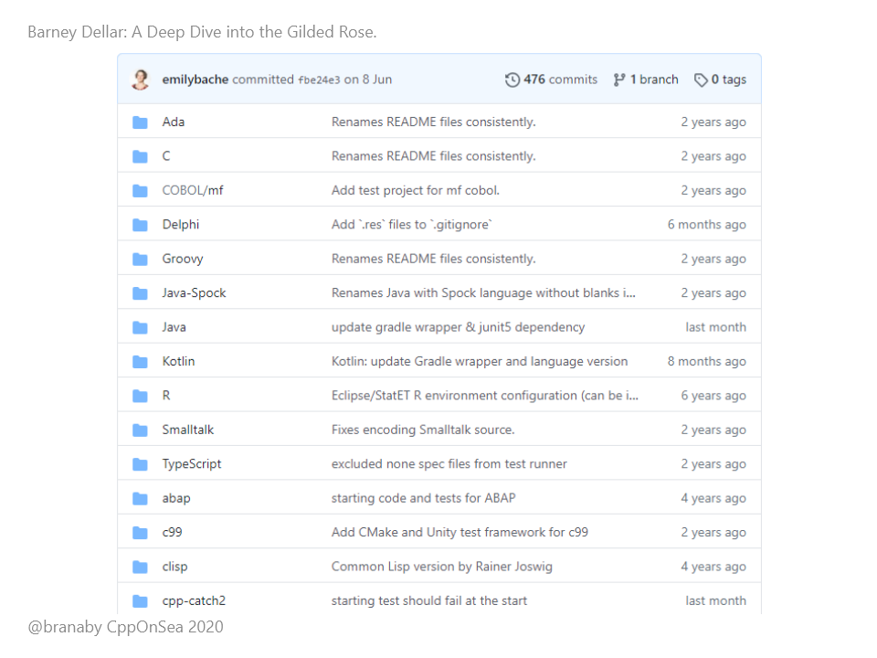
Notes:
This is a list of all of the languages available from Emily's GitHub. There's quite a few of them!

Slide 9
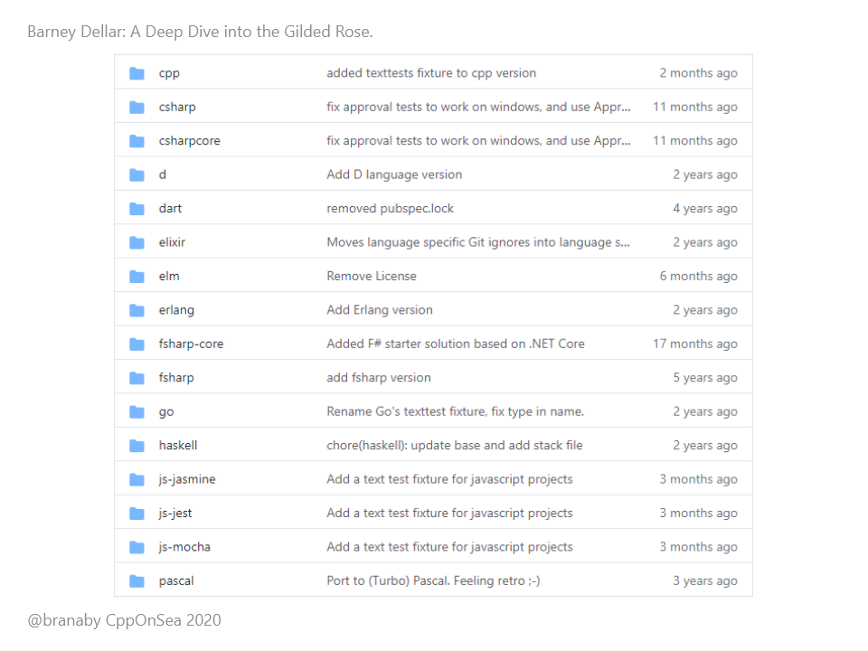
Notes:
And a few more...

Slide 10
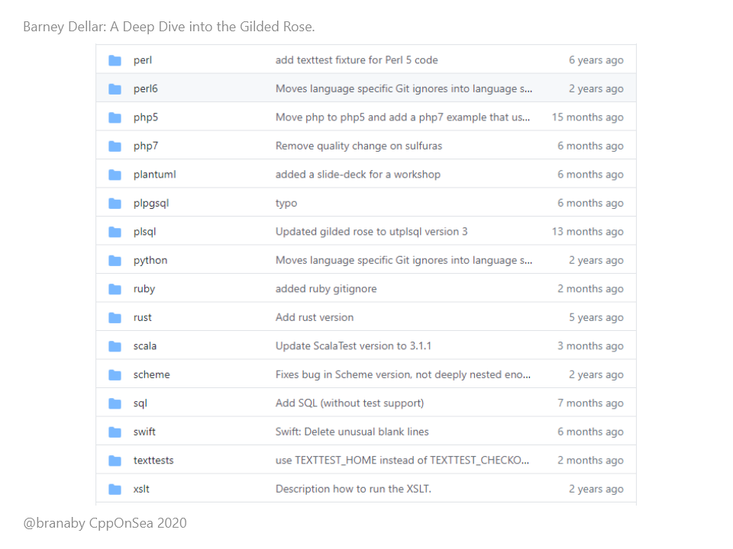
Notes:
And a few more.... Everything from perl to haskell to xslt to C++!

Slide 11
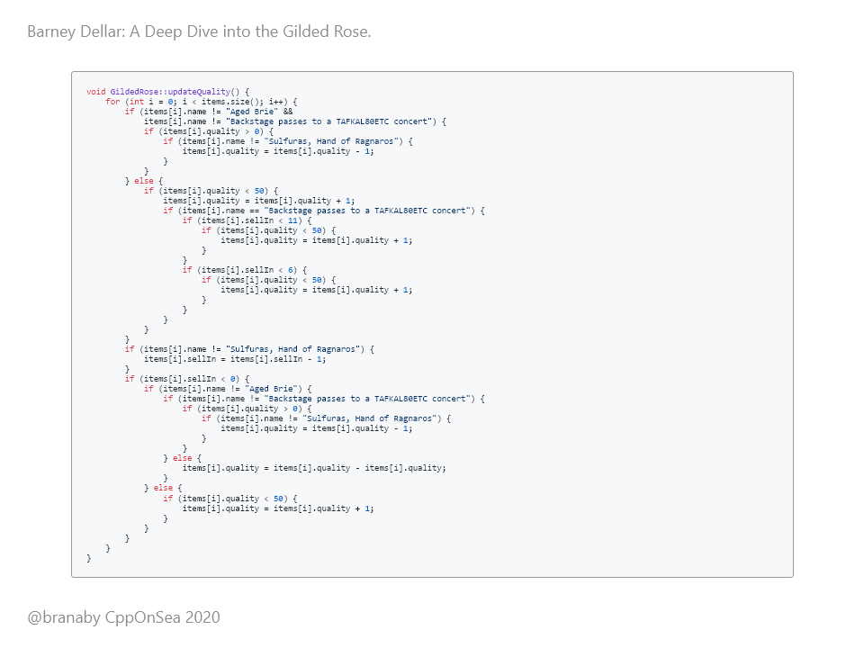
Notes:
The code for the function that you modify is only a few tens of lines long, but it's been deliberately design to be convoluted, entangled, confusing and unhelpful. There are documentation and tests, but, just as in real codebases, these can't be trusted. The only thing you're told is that the code is currently being used in a live system, so at least you know that it works, and that whatever its doing right now, you want it to keep doing that. And your job is to add some new functionality. So you want to get some tests to help you make sure that you don't break anything. And this is the function... <pause>

Slide 12
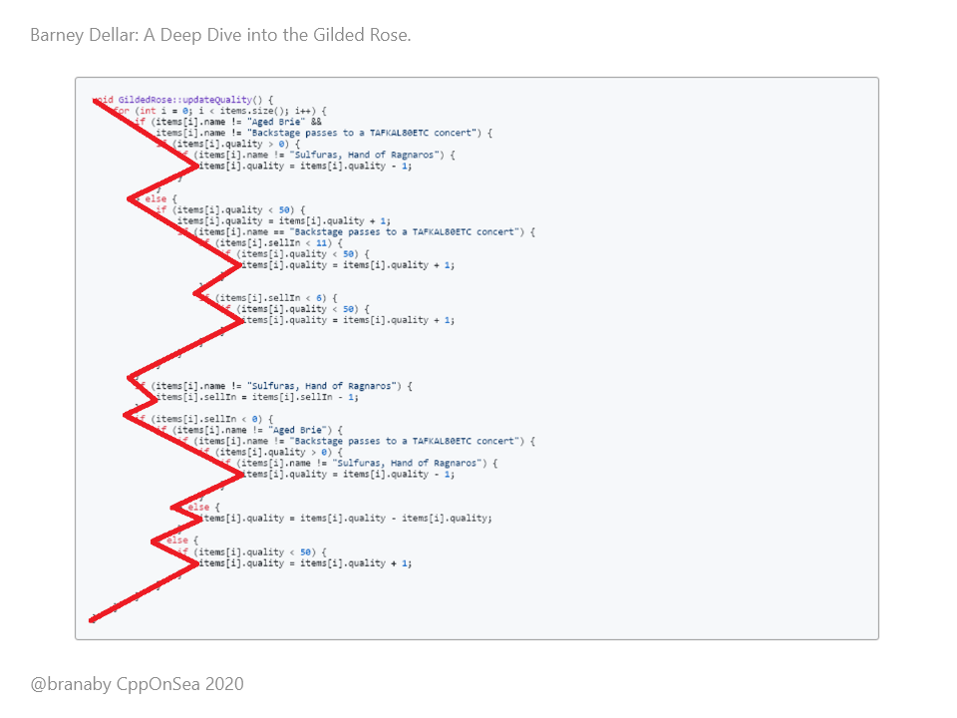
Notes:
Even just looking at the indentation in this function, we can tell that this is a mess. <pause> It's just full of branching based on conditionals... <pause> I'll zoom in a bit so we can see it in more detail.

Slide 13
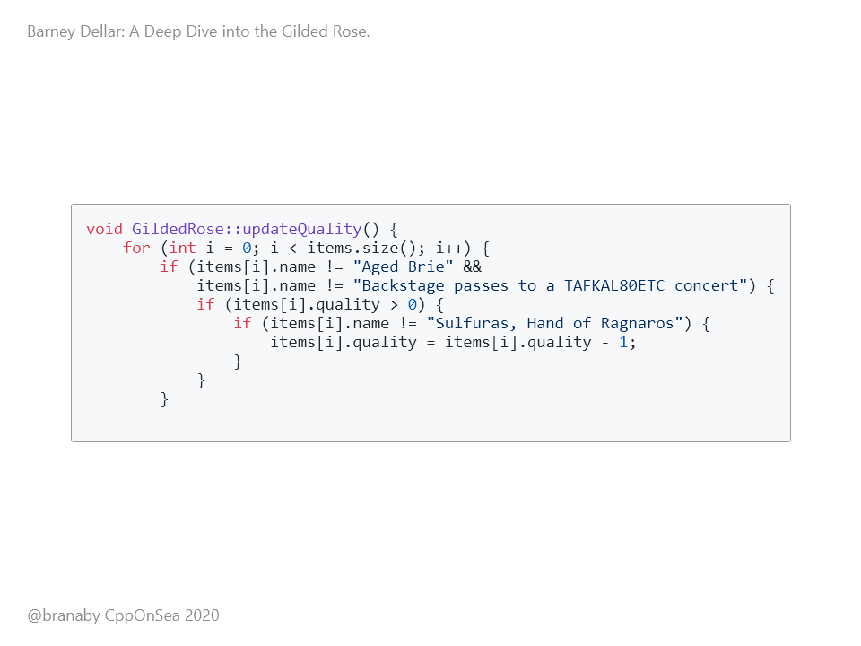
Notes:
We have a method on the GildedRose class called updateQuality. It loops through the items. For each item, if it's not aged brie *and* it's not a backstage pass, then, if the quality is above zero, and the item isn't sulfuras hand of ragnaros, we reduce the quality by one. Phew. That's the end of that if clause.

Slide 14
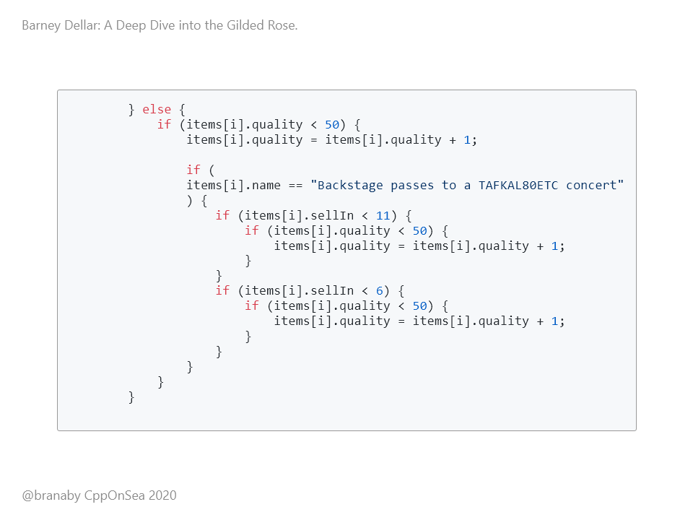
Notes:
Else... So that means it IS aged brie or a backstage pass, if the quality is less than 50, we increase the quality by one. If it's a backstage pass, and the sell-in is less than 11, and the quality is still less than 50, we increase the quality by another one... If the sell-in is less than 6, and the quality is still less than 50, we increase the quality by another one...

Slide 15
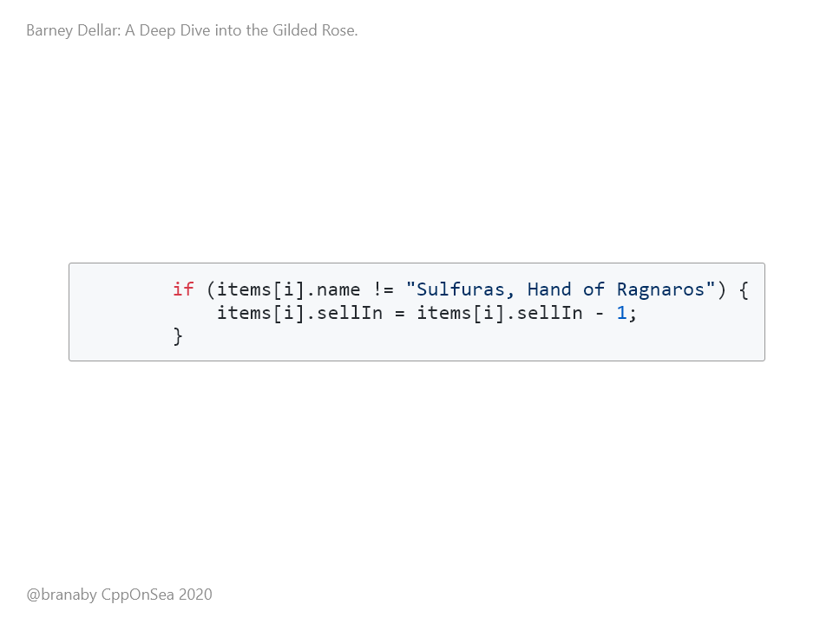
Notes:
OK, a top-level if. If the item isn't the Sulfuras hand of ragnaros, we decrease the sell-in by 1.

Slide 16
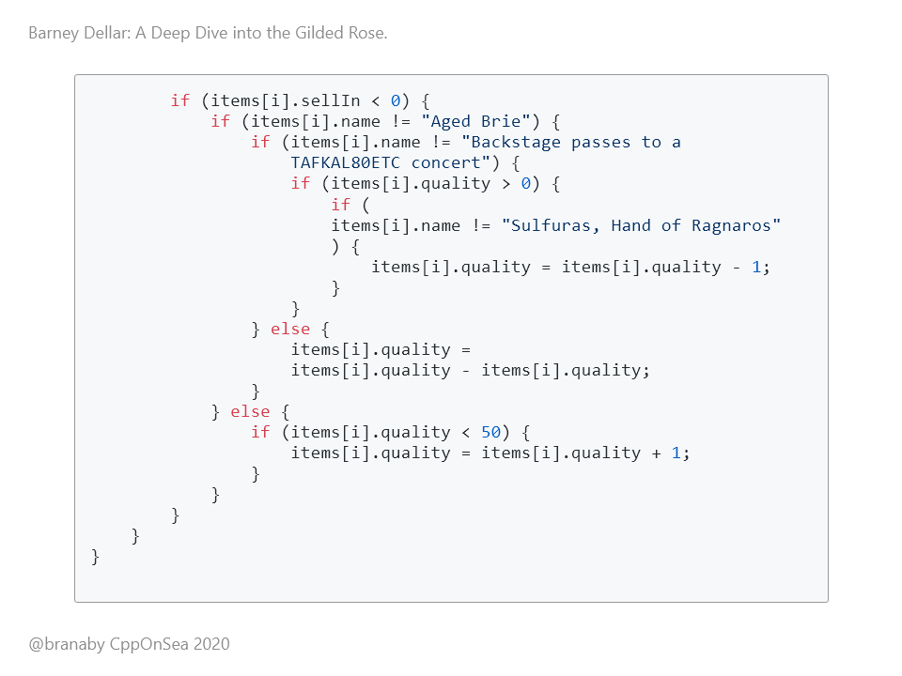
Notes:
If the sell-in is less than 0, and if it's not aged brie, and it's not a backstage pass, and the quality is > 0, and the item is not the Sulfuras Hand Of Ragnaros, we decrease the quality by 1. Else... So, if the item IS a backstage pass, we make the quality equal to the quality minus itself. Else, so if the item IS aged brie, and if the quality is less than 50, then we increase the quality by one.

Slide 17
Notes:
Now, I don't know about you, but I got lost almost immediately. Quality and Sell-in were being modified, but I'm not really sure how. Let's try the readme instead.

Slide 18
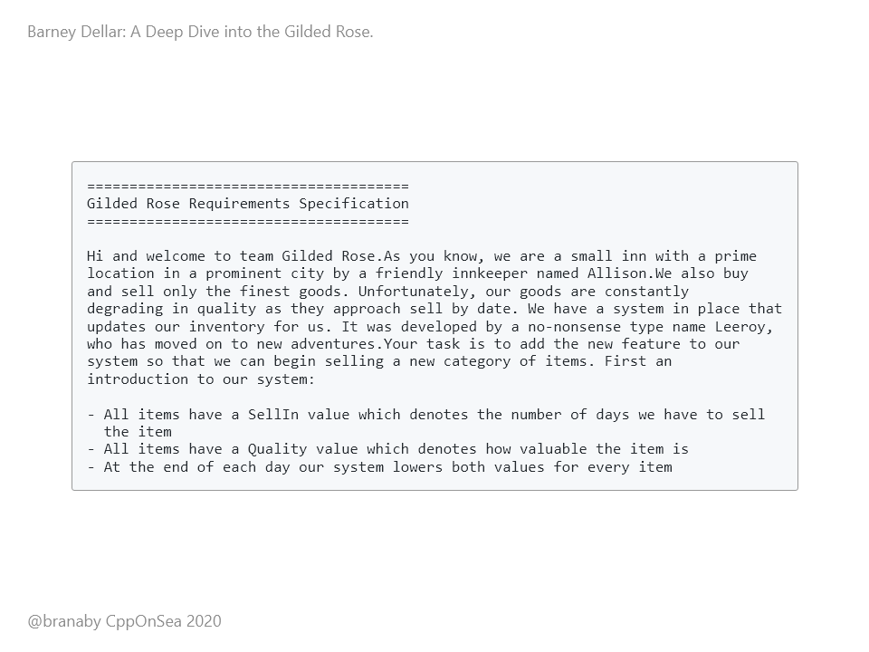

Slide 19
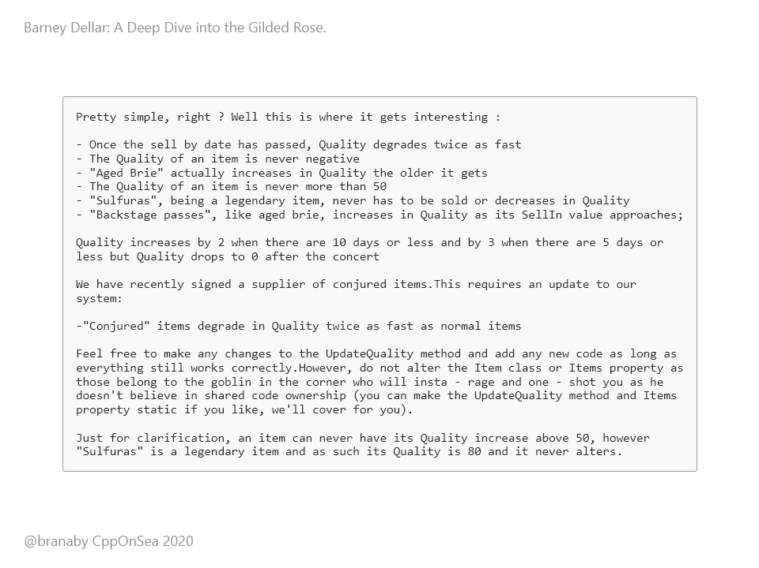

Slide 20
Notes:
Right, we have a running, live system, and our job is to update it to support conjured items. And conjured items lose quality twice as fast as normal ones. But we need to do this without changing the existing behaviour. And we don't understand the existing behaviour. I don't know about you, but I don't feel confident that I could modify the updateQuality method to support the new behaviour just now. Maybe there are tests in place that will help us. Yes, there are two unit test files:

Slide 21
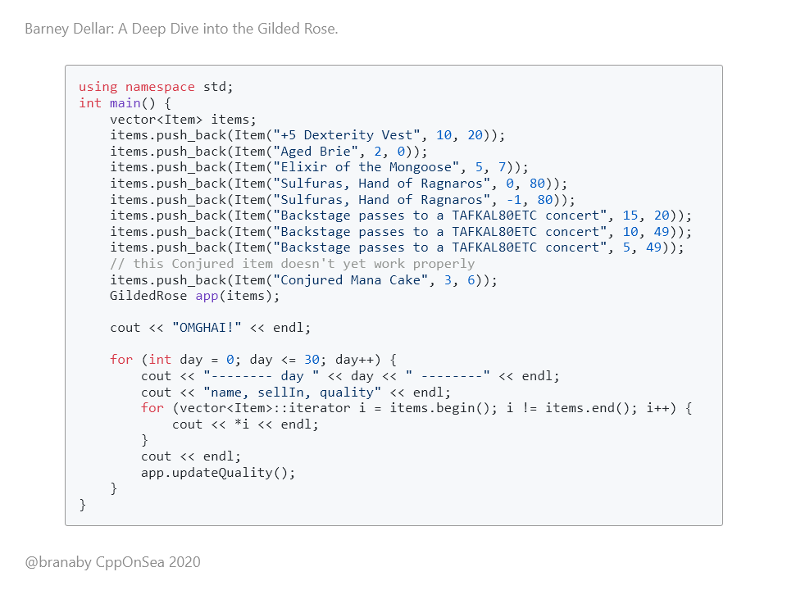
Notes:
OK... This is the first test file. It just has a main function that prints out the result of running updateQuality on some inputs 30 times. It doesn't actually test anything or assert anything. However, we can run this, and it does indeed print some values out to the console.

Slide 22
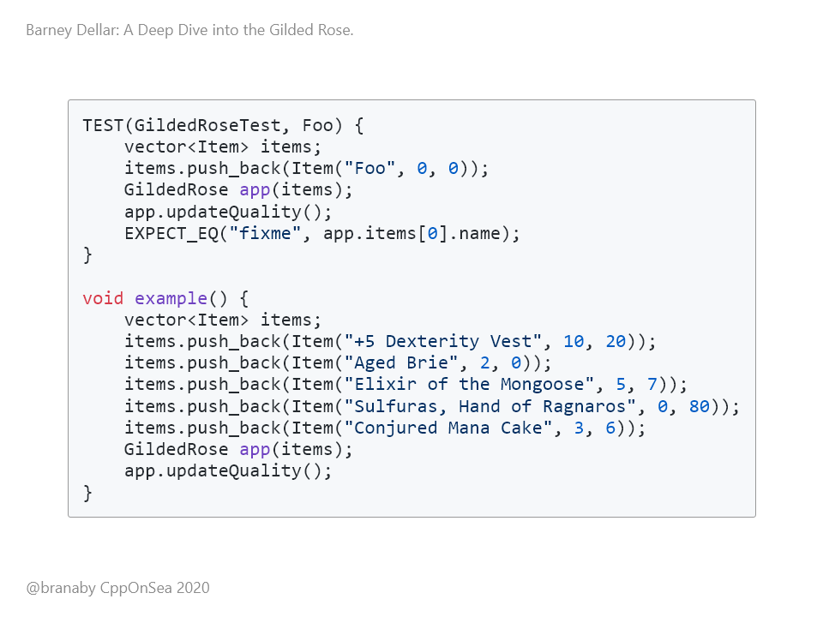
Notes:
This is the second test file. It does indeed have a test that runs. It makes sure that when an item called Foo is updated, it ends up with the name "fixme". This test fails. There's also a function called "example" which is never called. So clearly this code is NOT under test! This is a problem, because we need to modify the code, without changing the existing behaviour. But there are no tests to verify the existing behaviour. This is where Approval Testing can help! PAUSE

Slide 23
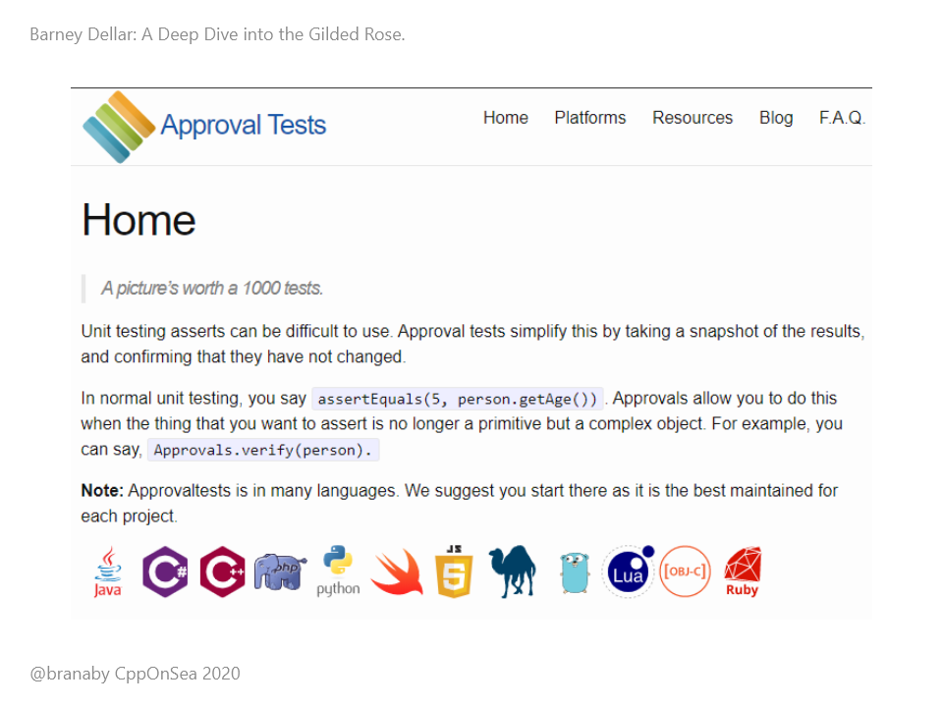
Notes:
Approval Testing is designed to help when you have a system that repeatedly gives consistent output given consistent inputs. They are a way of performing "Golden Master" testing. You create an "ideal" state, commit it, and then verify that subsequent runs of the test produce the same result. The Golden Master can be an image, a log file, a stream of text, anything. As long as you can compare two versions of the object and store it in version control.

Slide 24
Notes:
The C++ Approval Test library does not execute tests on its own. Instead, you can integrate it with a test framework, such as Catch2, GoogleTest, BoostTest, etc. I really like Catch2, especially for small projects, because it is very fast to set up.

Slide 25
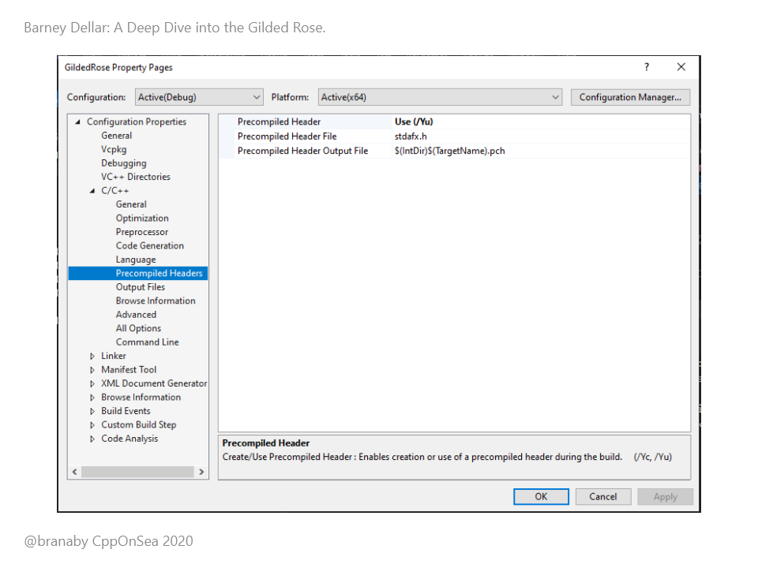
Notes:
So, we can set up Catch2, and then set up Approval Tests on top of that. Both Catch2 and Approval Tests are header-only libraries. This is great, as it makes them very easy to get going with. But the headers are BIG, and they get compiled every time you compile anything. And they're pretty slow to compile... Now, one of the goals of this kata was to practice Test Driven Development. And for that to work, you need rapid feedback between writing tests or code, and seeing the test results. So the first thing we did was to move the includes into the precompiled header.

Slide 26
Notes:
In this small codebase, this only had a small effect, but it's very good practice. By the time we had written all our tests, the debug compile time for a test change was 1.4 seconds with precompiled headers, and 2.2 seconds without. So, a 60% increase in compile time. And the time difference will increase as you add more tests if you do not precompile the test headers.

Slide 27
Notes:
So, back to testing. If we're going to use Approval Testing, we need some consistent inputs that produce some consistent outputs. In our case, we do have a main function that prints out the result for a collection of inputs by updating them every day for 30 days. If we run this function a few times we can see that the results are the same every time. We could store this output in a file, and then every time we make changes to the code, we could check the output against the one in the file to make sure that it hasn't changed. And Approval Testing does almost all of this for us!

Slide 28
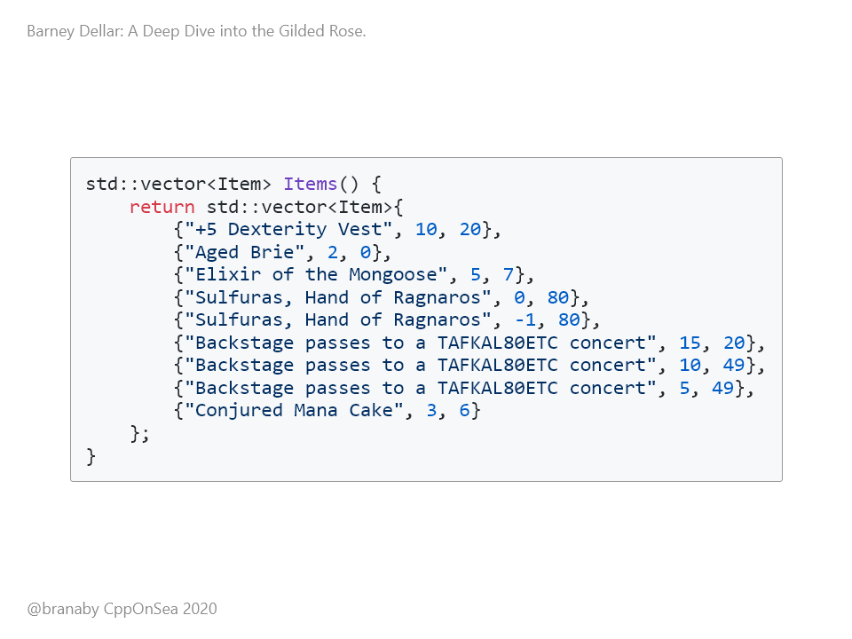
Notes:
We can turn this function into an Approval Test fairly simply, once we have the test framework in place. First, we extract a helper to create the items. This is the same code we saw before. Each item gets added to a vector, and then the whole vector is returned.

Slide 29
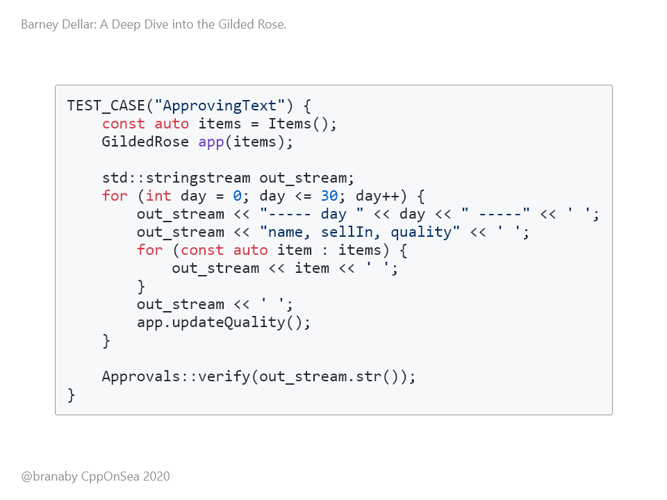
Notes:
And then, instead of writing the output to cout, we use a stringstream. We then ask Approval Tests to verify the string for us. And we're done. It's as simple as that. We have a test in place.

Slide 30
Notes:
So what happens when we run the test? The test framework runs the "ApprovingText" test case, generates a string, and then it hits the "Approvals::verify" step. At this point, it tries to compare the result with... something. But there's nothing to compare it to.

Slide 31
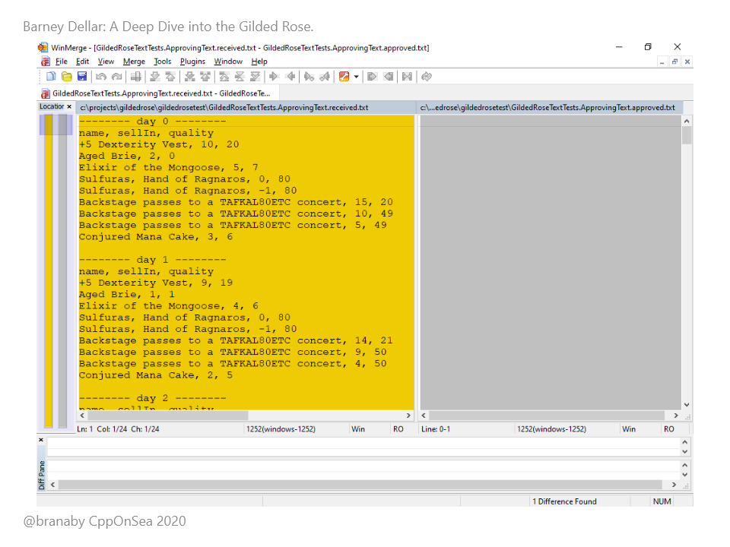
Notes:
Luckily, the framework expects this, and it pops up a diff tool for us. In my case, it just magically finds winmerge. On the left is the new output, and on the right is nothing. All that I need to do is copy over the output to the right, save, and exit. The test run then finishes, and the "golden master" output is stored in a text file. This first test run actually fails, but if we run it again it passes silently. (16 mins)

Slide 32
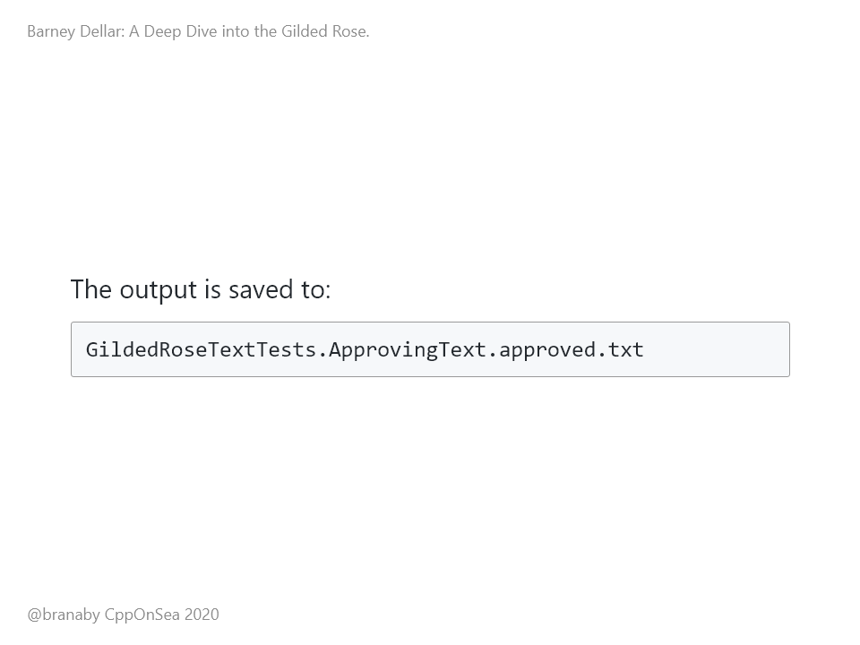
Notes:
The framework even chooses a nice name for the file for us!

Slide 33
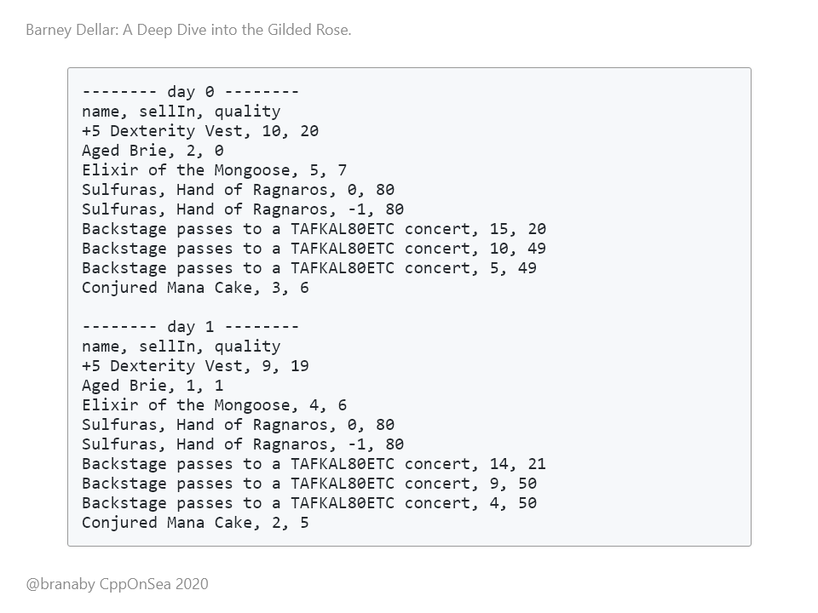
Notes:
The output is something like this, going on for the 30 days. And if I run the tests again, they pass, with no prompt from Winmerge, because the output is identical. But if I change the behaviour, and re-run the tests, the system detects the difference, and prompts me to look at the change in winmerge again. All that remains to be done is to commit the new approved output, so that it lives alongside the code.

Slide 34
Notes:
So, that's great. We have some tests running, and these are now committed. But... How do we know if this test is comprehensive? The inputs are just the random strings that were in the unused test Main() function. We can tell that *some* code is being invoked, because the values in the output change day to day. But are the tests covering all of the production code? We need a code coverage tool!

Slide 35
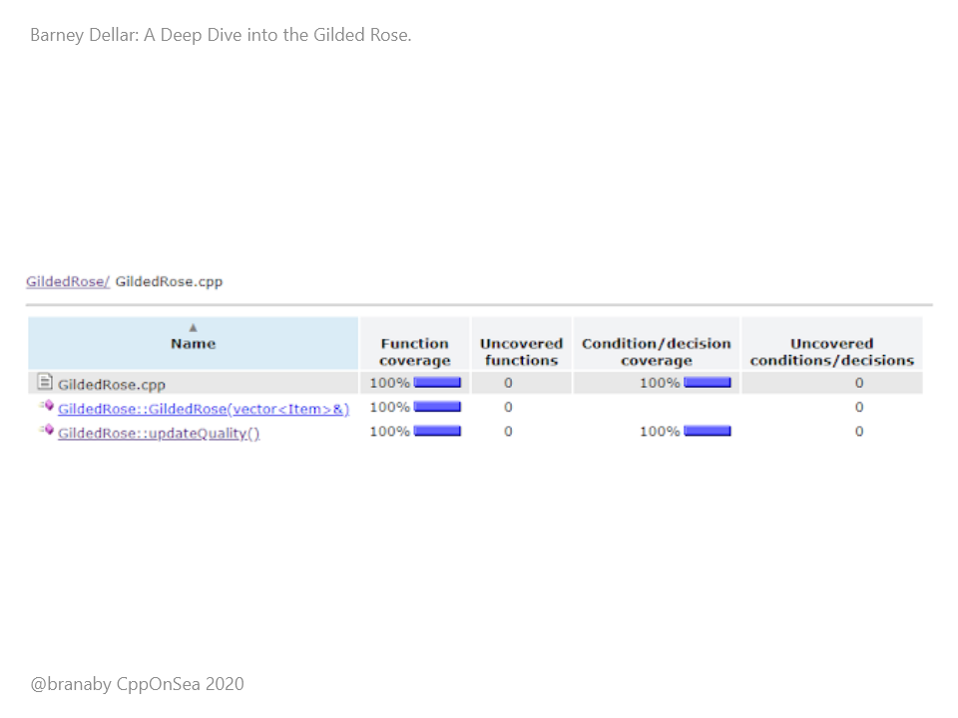
Notes:
On my team, we normally use Bullseye to check our code coverage, with integration into Visual Studio. So, we can turn on Bullseye, rebuild, run the tests, and then have a look at the output. We can see that every part of the UpdateQuality() function has been called. That's good, because the test is just one that we found lying around, with a bunch of random inputs.

Slide 36
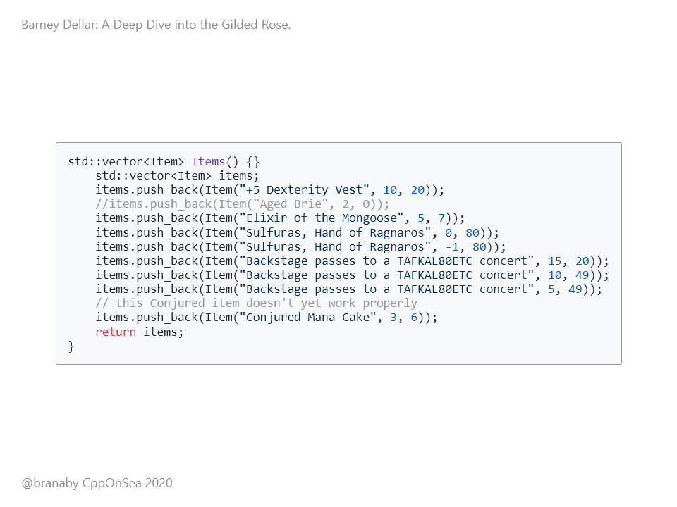
Notes:
I always like to double check that my results are good. Imagine if we didn't have the Aged Brie in the list of items. It's commented out here:

Slide 37
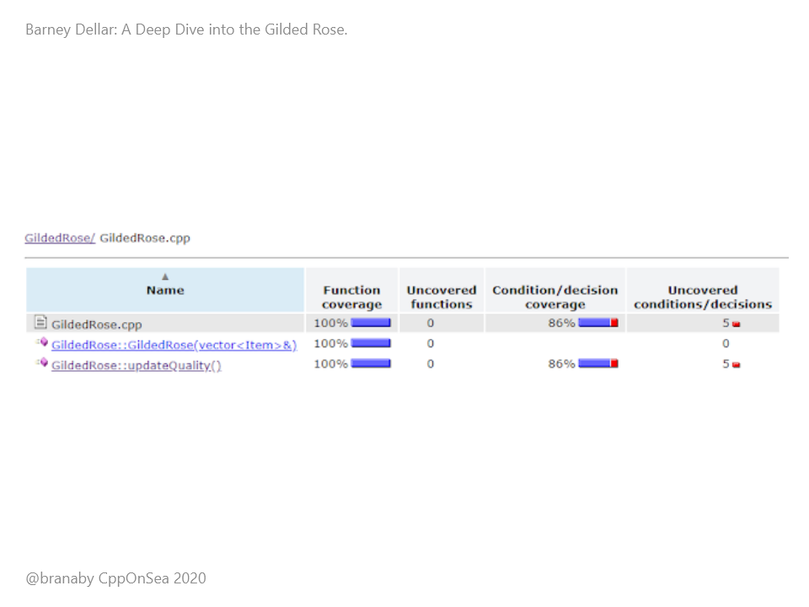
Notes:
If we run the tests now, we can clearly see that we no longer have full coverage. So, this tells us that our Approval Tests are giving us 100% coverage, and we haven't had to investigate any production code or behaviour at all yet. Nice :-) Now, full code coverage doesn't tell you that tell your tests are good. It just tells you that they *might* be good. A test that invokes every line and then just asserts true has no value.

Slide 38
Notes:
In our case, we can see that the full state of each Item is being printed out, and that they're changing as we call UpdateQuality. And we also know that this output is being checked to make sure it doesn't change. So we can be pretty confident that we have a good test harness in place.

Slide 39
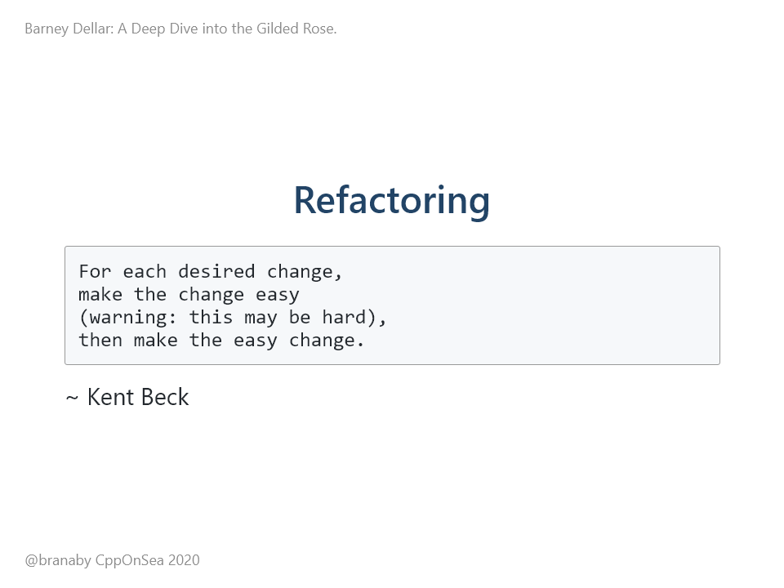
Notes:
So, we have a test harness, but the code is still a mess. And we need to add new functionality. So first, we're going to tidy up the existing code. If we change the behaviour, our tests should tell us. Refactoring is also a great way of learning about a piece of code.

Slide 40
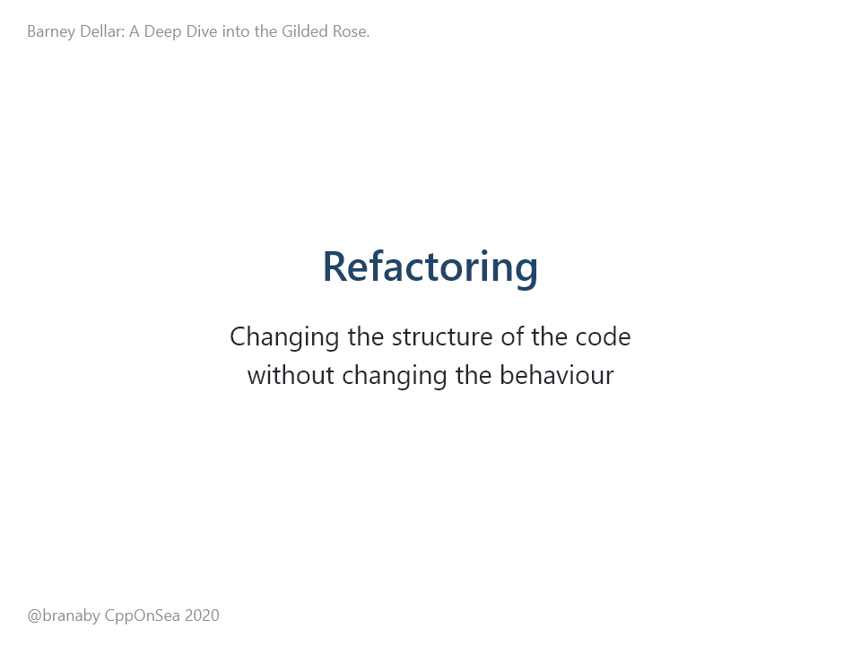
Notes:
The goal of refactoring is to change the structure of the code, without changing the behaviour. With refactoring, it's really important to take small steps. We do this by making small changes, running the tests, and then committing. Changes that make the tests fail can just be reverted.

Slide 41
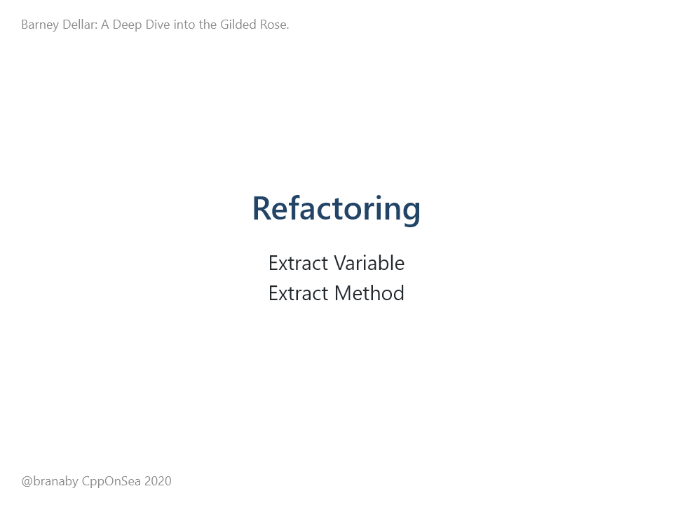
Notes:
The first step we can take is to remove one of the two test files. We have made one work for our Approval Tests, and the other just declares a broken test, and an unused function. So it can go. Once we've done that, we can look at our UpdateQuality method. Most of the changes we make are going to be either Extract Variable, or Extract Method. These are standard refactorings, where you pull a complex expression out and give it a name, or pull a complex piece of logic out and give it a name.

Slide 42
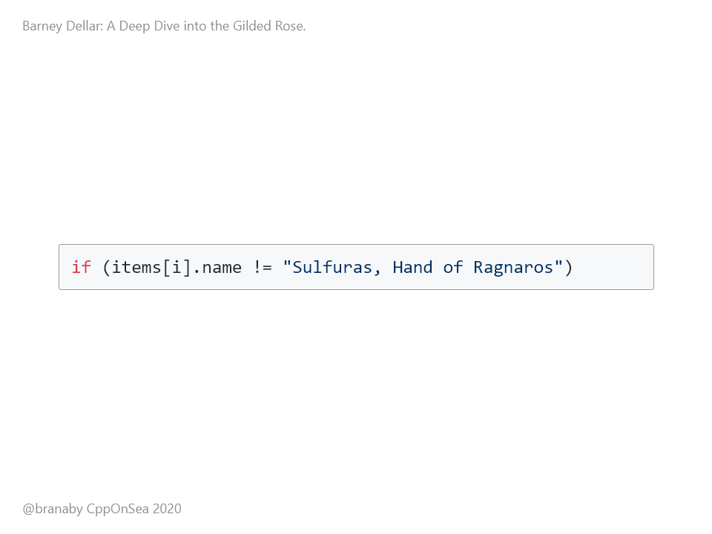
Notes:
OK, on to the refactoring. As an example of Extracting a variable, we have a few places that check if the the item name is not "Sulfuras, Hand of Ragnaros".

Slide 43
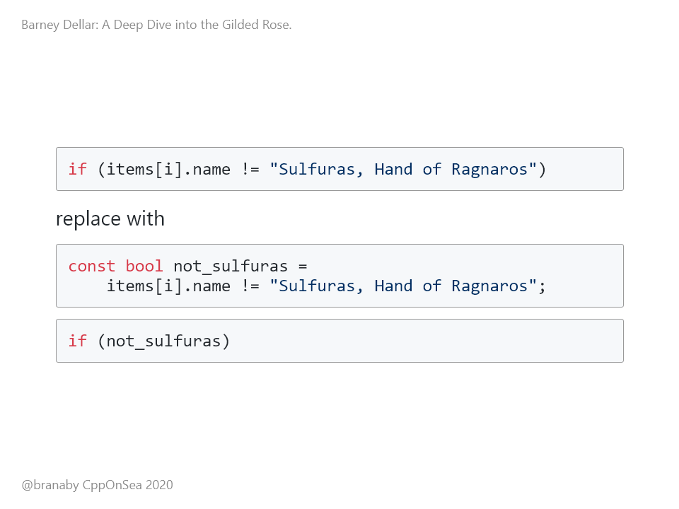
Notes:
We can easily introduce a variable and use that every time. Note that this also makes the if statement easier to read, and easier to understand. We've raised the level of abstraction away from comparing the name of the ith item against another string, to looking at what kind of item this is. We've given a good name to what was just an anonymous experssion. We can then run the tests and make sure that they still pass. This kind of refactoring is a really easy way to start exploring complex legacy code. Each change makes the code a little bit easier to understand. But it also gives us a way of walking through the code, to help us build up a mental model of it. And as we build up that mental model, more and more complex changes become more and more obvious.

Slide 44
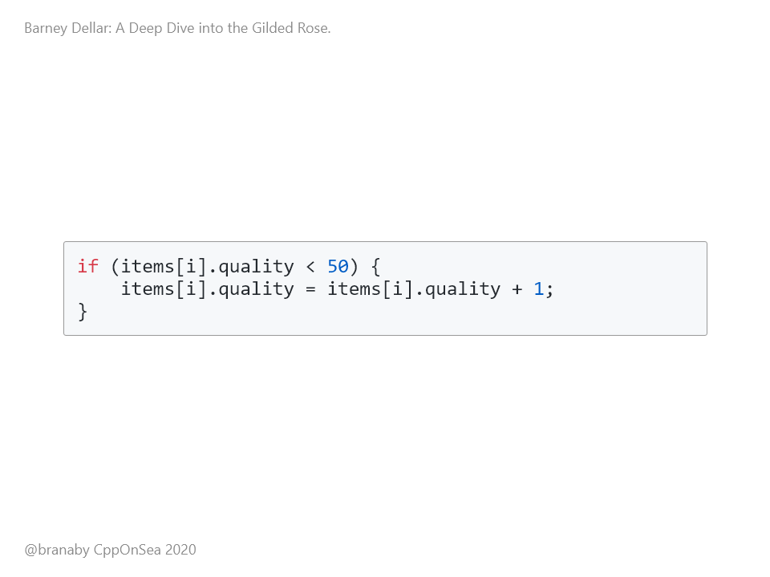
Notes:
As an example of Extract Method, this code pops up a few times in the updateQuality method

Slide 45
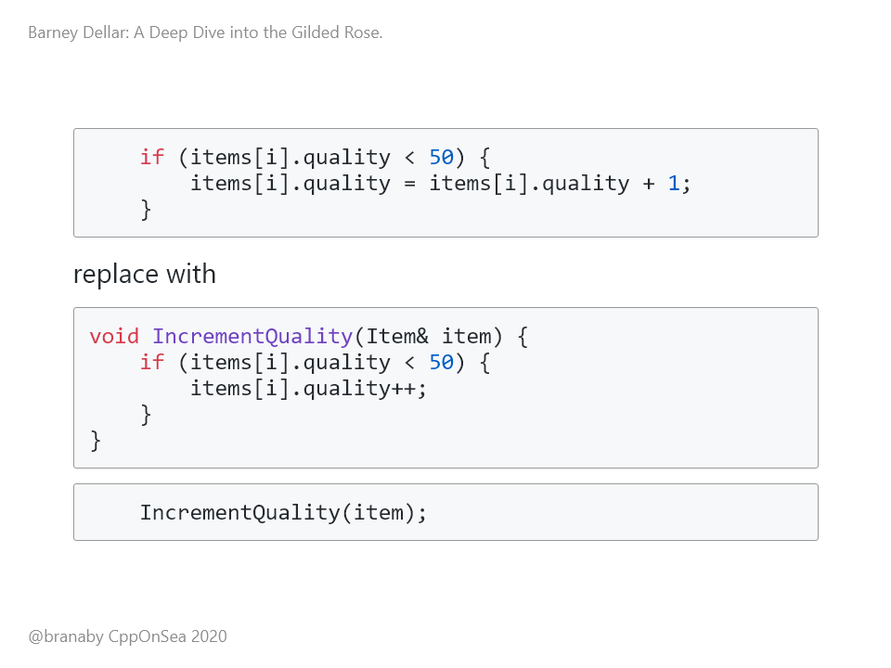
Notes:
We can move that code into a helper function, tidy it a bit, and call it instead. And again, we have given a name - hopefully a good name - to what was just a block of code.

Slide 46
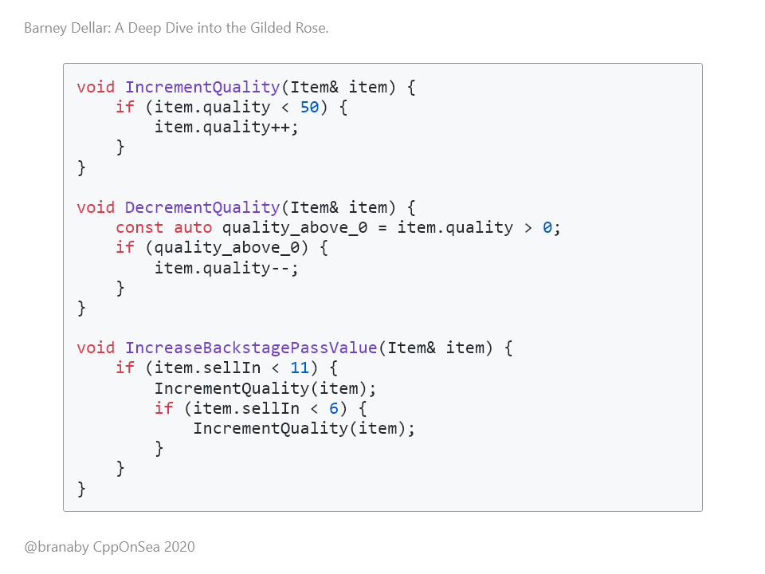
Notes:
And, after a few iterations of this, we can get to something like this. We've extracted out some useful helper functions, each of which is small enough to understand.

Slide 47
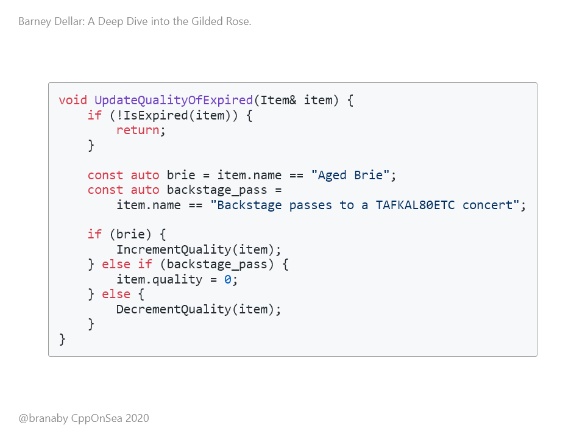
Notes:
Some of the helpers are bit more complex, like this one. But it's still possible to reason about them

Slide 48
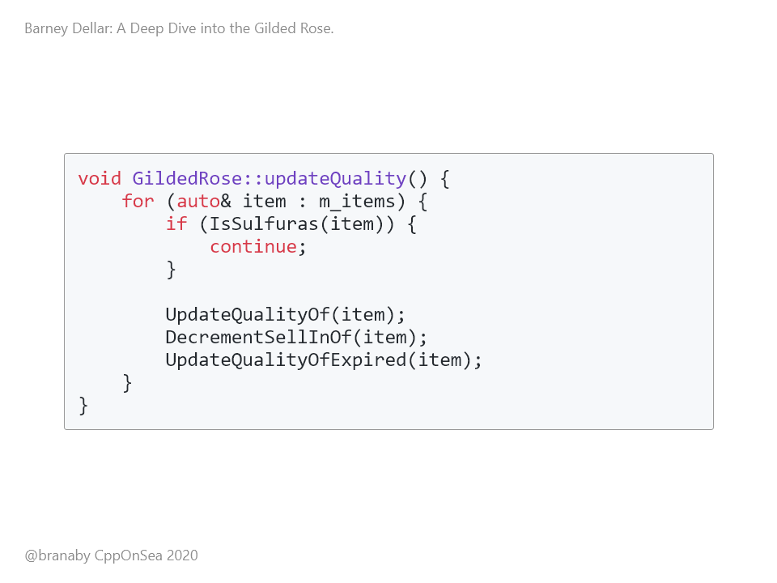
Notes:
But the end result is that our actual updateQuality method is easy to understand. We iterate over all items. We skip Sulfuras. We then update the quality and decrement the sell-in. And then we update the quality for expired items. Done. It turns out that that was what the original 50 line function was doing.

Slide 49
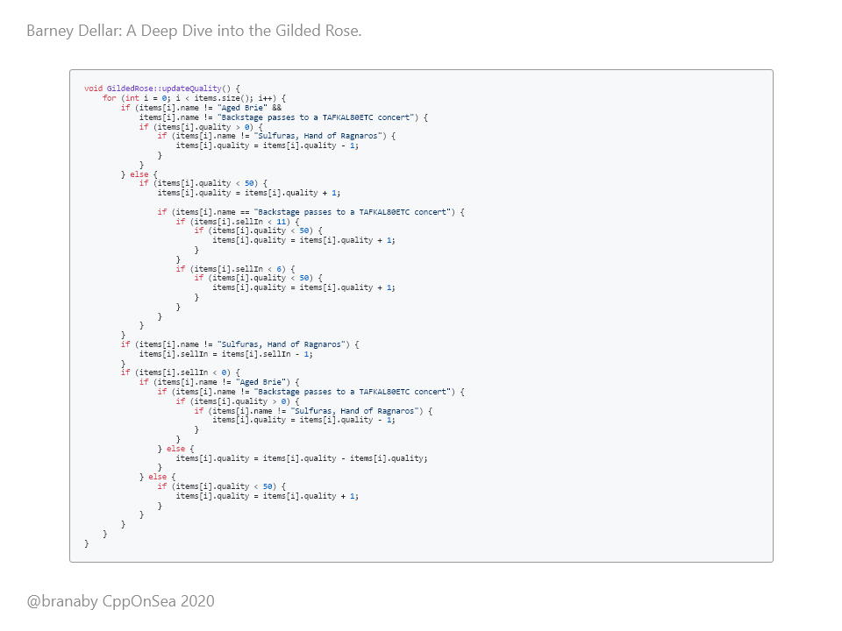
Notes:
For comparison, here is the original version. And we were able to make these changes because we had the Approval Test harness in place.

Slide 50
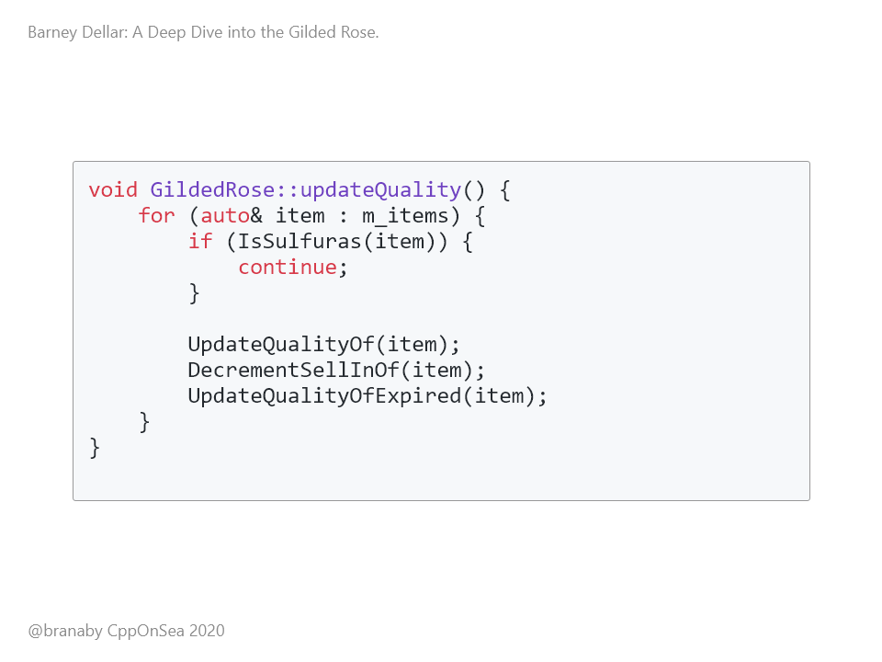
Notes:
I hope that you agree that this is much more understandable. The functions are much smaller; there are no crazy nested conditionals, and the code has been modernised a bit. If you want to see a masterclass in refactoring this kata, I've included a link at the end to Sandi Metz solving it in Ruby. But either way, our code is now understandable enough for us to try and implement the new requirement. (24 mins)

Slide 51
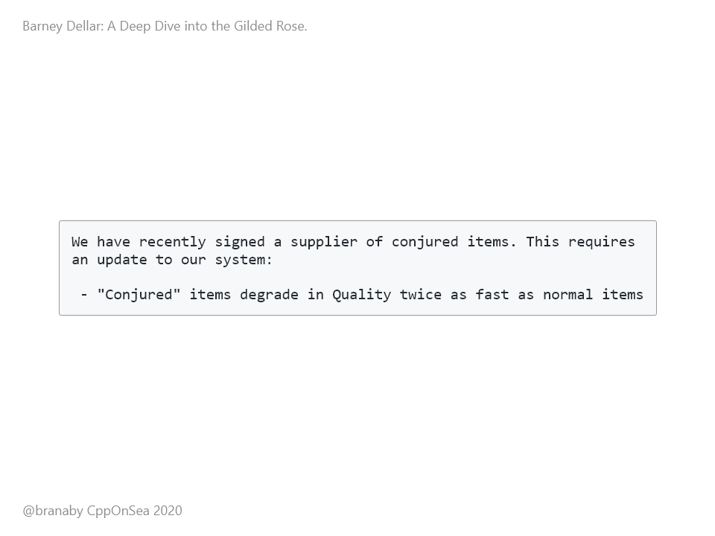
Notes:
Let's check the new requirement again. Here is the relevant section from the Readme: We can now move on to adding this feature.

Slide 52
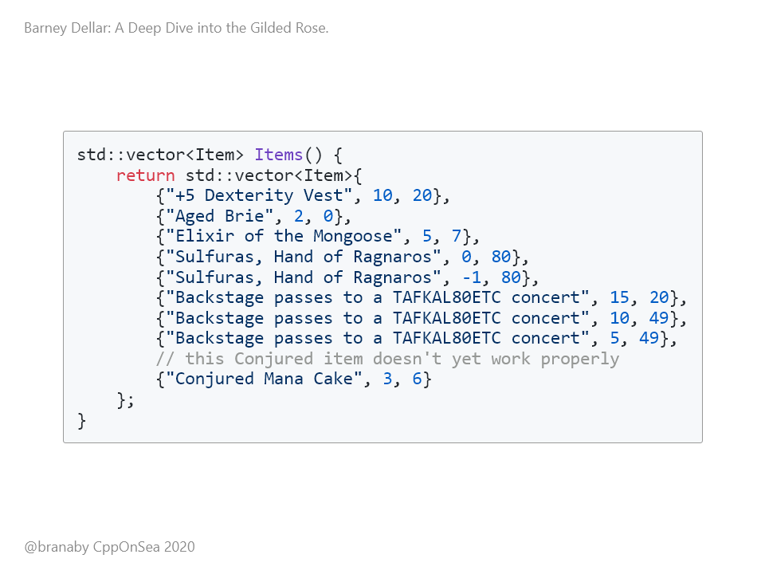
Notes:
OK, we need to support "Conjured" items, whatever they are. If we look at our Approval Test, there is a hint there too: It looks like someone in the past thought that you should define a conjured item by starting the name with the word "Conjured". We can work with that.

Slide 53
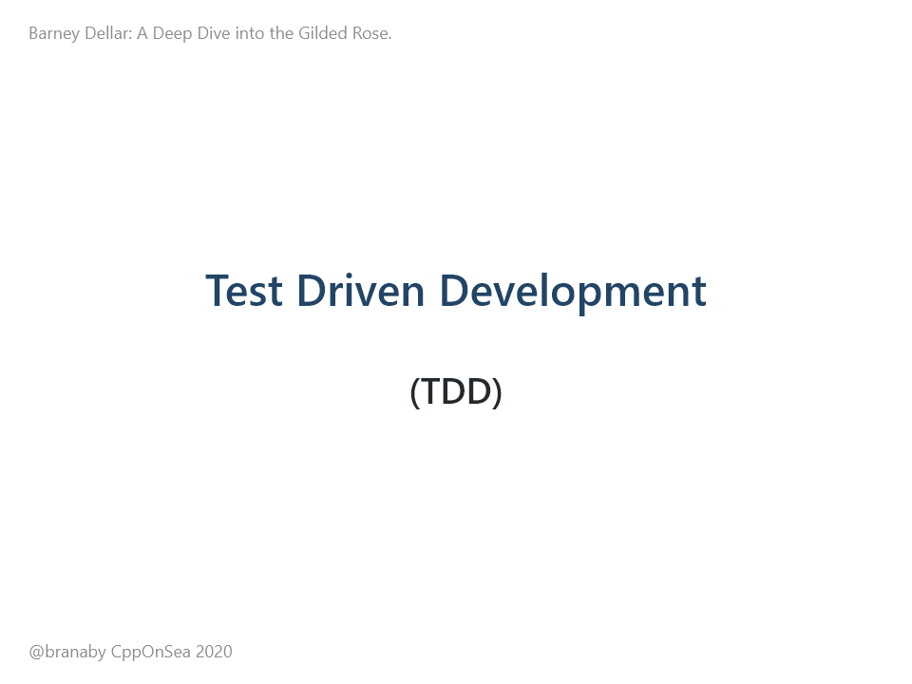
Notes:
For the new requirements, we'll use TDD. As I mentioned before, katas such as this are a great way of practicing skills such as TDD. The idea is to add a small requirement in the form of a test, and then implement just enough code to satisfy the requirement.

Slide 54
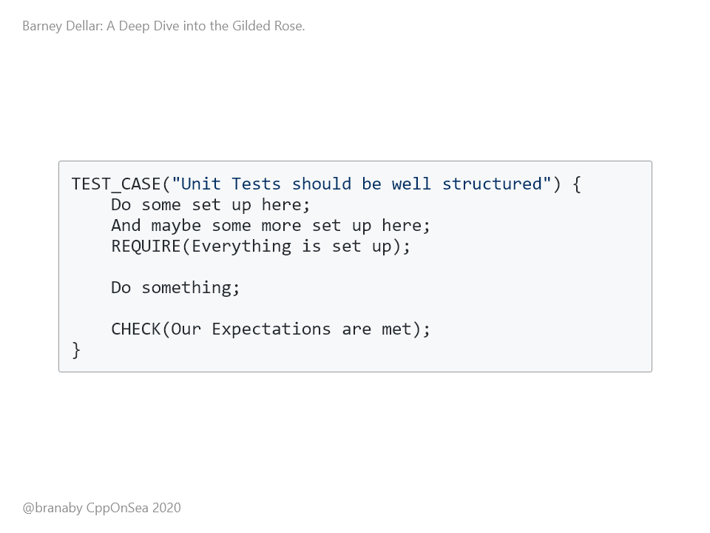
Notes:
Each unit test should be just a few lines long. It's good practice to break these up into three blocks: Arrange Act Assert, or Given When Then. First we Arrange things. You can use the REQUIRE test here, which will halt if things haven't been set up properly. Then we Act. This should be single action. When we do this, Then we expect our assertion to pass. And ideally there should be a single assertion. We use CHECK here, which will not halt execution if it fails. This is so that if we have two CHECKS, we can see if they both fail, or just one fails if we get any failures.

Slide 55
Notes:
I like to use two blank lines to break up the test. If you need more blank lines, your test is probably too complex and should be broken up. It's also good practice not to over-constrain the assertion. If you're testing that something should log, just test that it logs. Don't test the exact log message. Overly strict tests prevent you from changing code later.

Slide 56
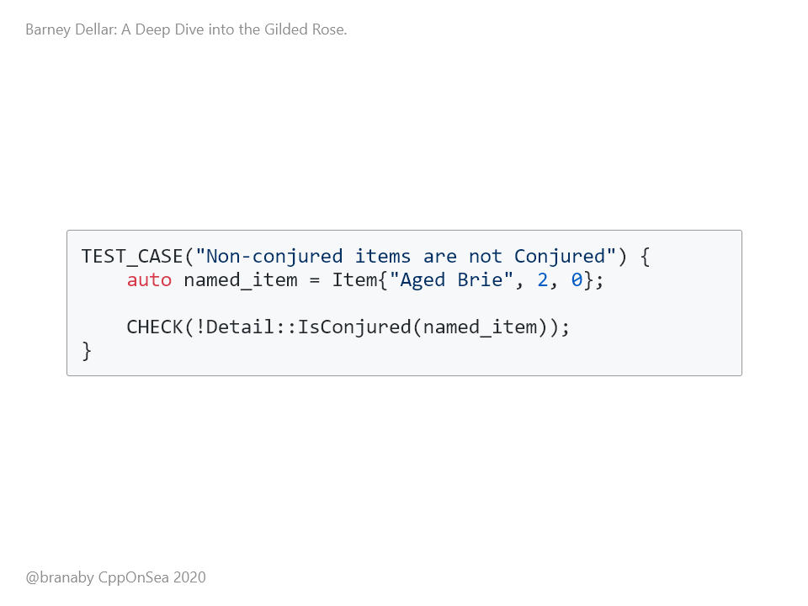
Notes:
OK, our first test detects whether something is not conjured. There is no real Action here. This test fails initially, because we don't have an IsConjured() function. So we need to add that:

Slide 57
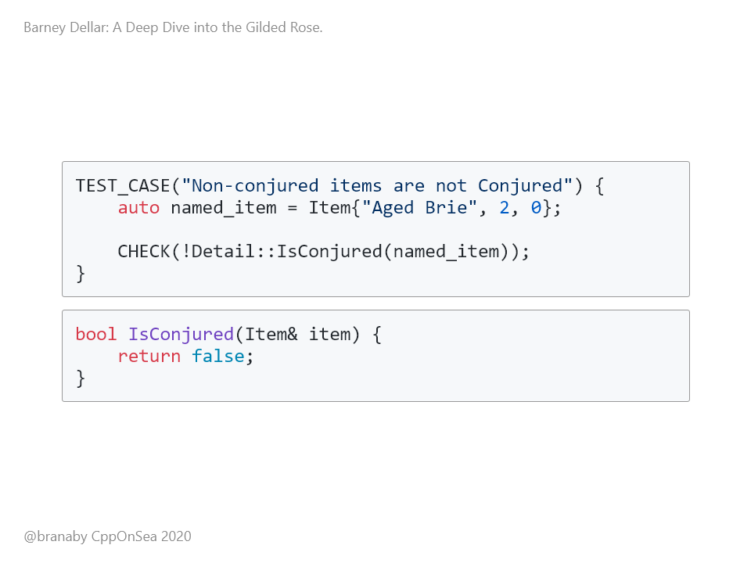
Notes:
The function just always returns false. The tests pass, so we can commit :-)

Slide 58
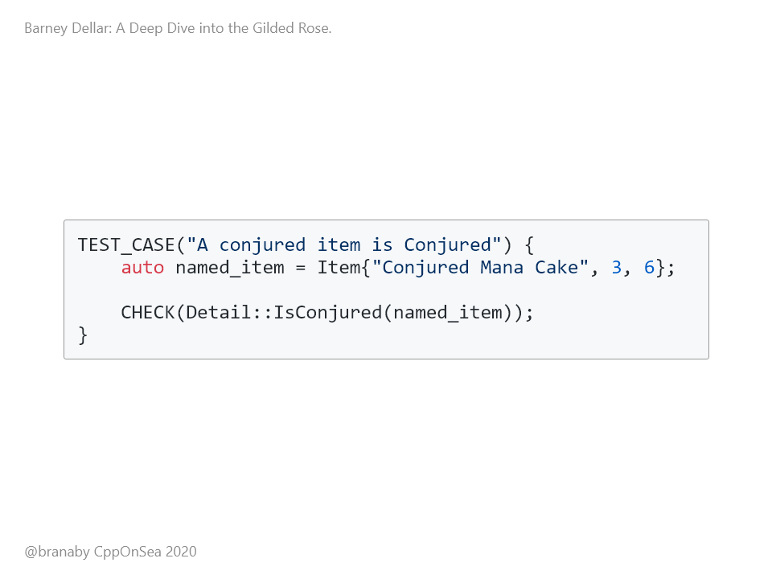
Notes:
Now we can add a test to detect that something is conjured:

Slide 59
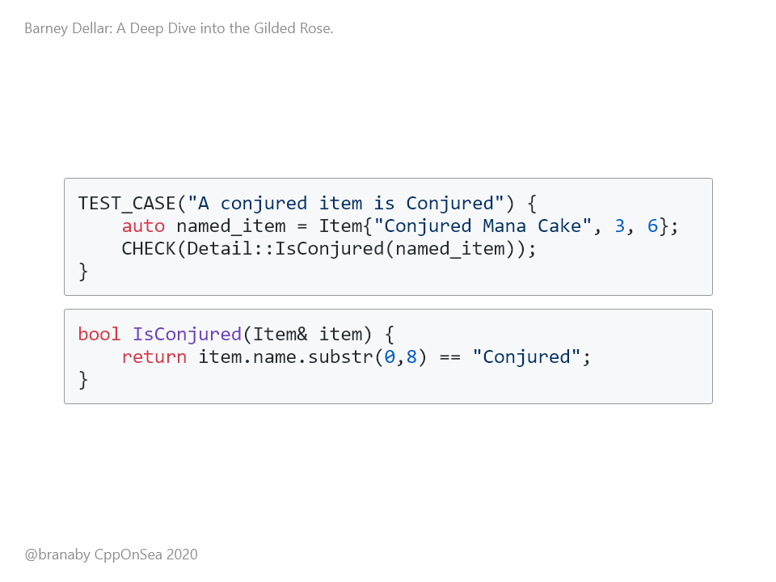
Notes:
This now forces us to do something more clever in our implementation. This is known as Triangulation in TDD. You add a test that forces some change in direction in the code. Both tests pass, so we can commit again.

Slide 60
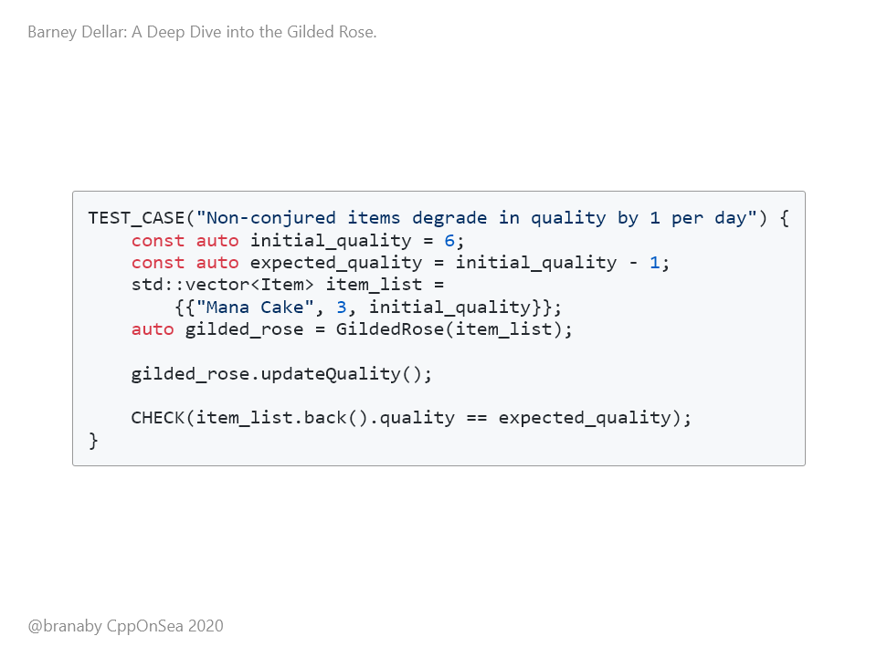
Notes:
We can now move on to look at quality. We can start by testing our assumptions about the current behaviour. We expect non-conjured items that have not expired to decrease in quality by one per day. We expect this test to pass, and it does. Great, our assumptions match reality. We can commit this new test, and then move on to the real requirement...

Slide 61
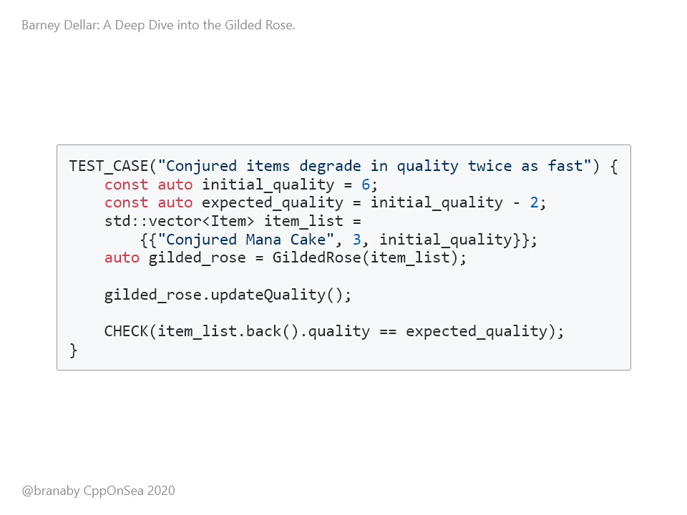
Notes:
In this test for conjured items, we use conjured mana cake. We want its quality to go down by two instead of one. As expected, this fails right now, so we need to make it pass.

Slide 62
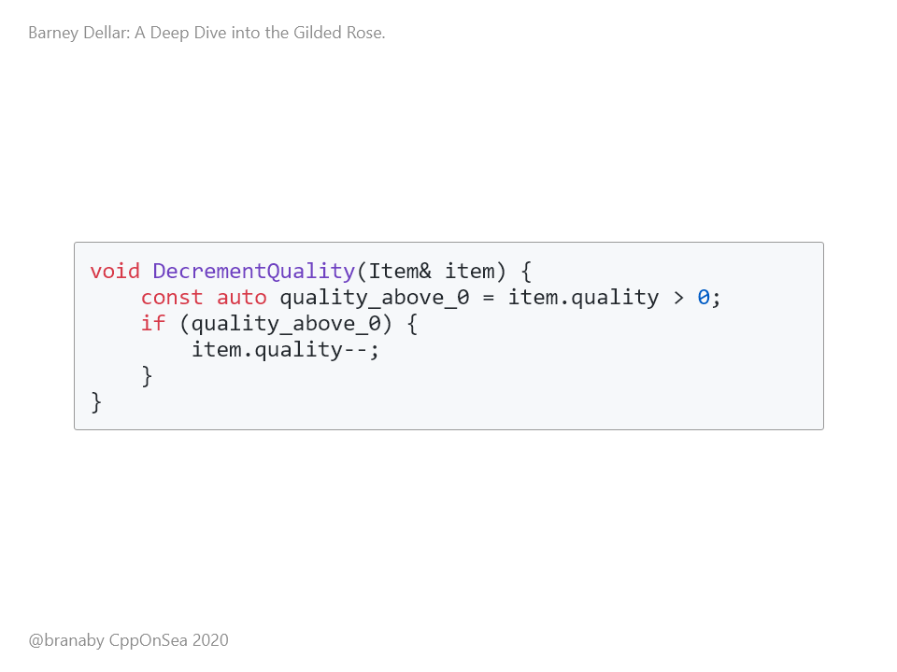
Notes:
We have our existing DecrementQuality() function:

Slide 63
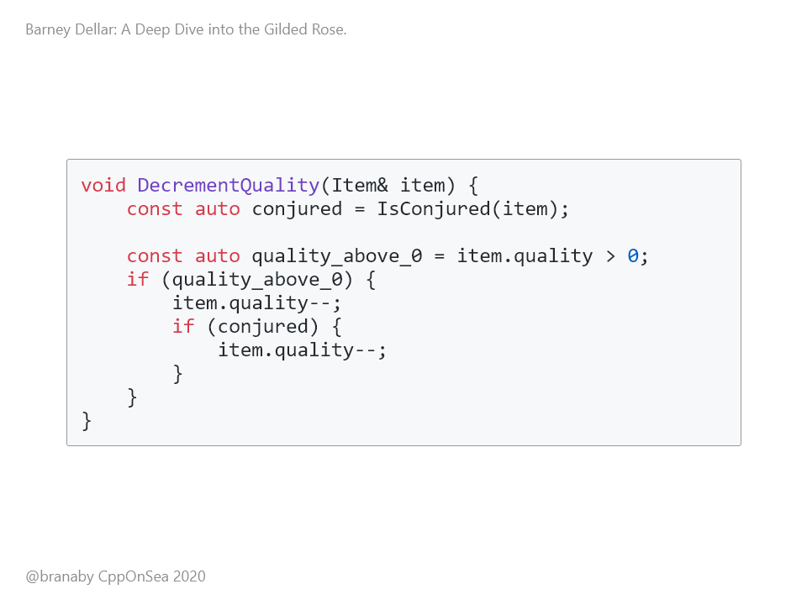
Notes:
And it is not too hard to modify it to make use of our new IsConjured() function, and to decrement the quality again for conjured items. This passes our test :-)

Slide 64

Notes:
Ah, but now our unit tests pass, but our Approval Tests fail... Of course, the Conjured Mana Cake is now losing quality at twice the speed, so we get different output.

Slide 65

Notes:
Here's the four changes. So, we can check the new output, make sure it's fine. As we can see, the conjured mana cake is now degrading twice as fast, as expected. So we can copy the new output over to the Approved file. This can then be committed as the new Gold Standard.

Slide 66
Notes:
If we look at our new DecrementQuality() function, we can see that we are decrementing the quality twice if the item is conjured. This is fine if the quality is large enough. But what if the quality of a conjured item starts at 1? We'll decrement it once, and then again because it is conjured.

Slide 67

Notes:
We should add a test for this! This fails right now

Slide 68

Notes:
We can make this pass by checking the quality before decrementing it again. This is ugly, but at least it works, and we could start refactoring and tidying again, now that all tests pass. (30 mins)

Slide 69

Notes:
We have pretty much finished the original kata here, but it's always good to leave the code in a good state for the next person to come across it. Always leave things in a cleaner state than you found the. And the main thing that's missing at the moment is comprehensive unit tests. So we should add them, and refactor as we go. And it was while doing this with my team that we discovered a very nice feature of Catch2: Generators. These go a long way to giving us Property Based testing in C++

Slide 70

Notes:
Let's look at an example. We have an IncrementQuality() function, and this should never increment the quality if it's more than 50. So we have some interesting edge cases to think about. Obviously, any quality below 50 should get incremented. So 3 should go to 4, 10 should go to 11. And 49 should go to 50, but 50 should stay at the same value. And so should anything above 50. The function works on ints, so we should make sure it copes well with extreme values, like the min and max int values

Slide 71

Notes:
In other words, we're very interested in the few values around 50, to make sure that we're not out by one, and we're slightly interested in the numerical limits, and zero's often a value that can go wrong. And we want it to work for any other value in between. So we want to write tests that reflect that interest.

Slide 72

Notes:
Initially, we wrote tests for 0, for 1, for 49, for 50, for 51, and for the numerical limits. But it was very verbose. And there's loads of duplication in the tests, as you can see. So the intent behind the tests becomes lost in all the noise of repeated tests.

Slide 73

Notes:
We also end up with horrible arbitrary hard-coded numbers. Someone reading this might think that they're chosen for a good reason, but they're not.

Slide 74

Notes:
Then we discovered generators. They allow you to specify a list of values, and to run the test for all those values. So this test now runs three times: once for int_min, once for zero, and once for 49.

Slide 75

Notes:
But you can actually go even further. You can specify a range, you can ask for random numbers from a range, you can apply filters etc

Slide 76

Notes:
So we ended up with this. We take the minimum numerical limit, 100 random numbers between that limit and zero, and every number between 0 and 49. To make it explicit, we also list 49 as a single value. And then we make sure that the quality is incremented.

Slide 77

Notes:
In the second test, we take 50 explicitly, and then every number between 51 and 60, 100 random numbers between 61 and the max numerical limit, and the max numerical limit itself. And with that, we've really captured our requirements for the function in two very expressive tests. We don't have to arbitrarily choose random numbers and test them.

Slide 78

Notes:
So, we added in unit tests using these really nice generators. The last thing I wanted to go through with my team was the idea of using Test Doubles. Historically, C++ has lagged behind other languages with support for these, but there have been big improvements in recent years..

Slide 79

Notes:
So I gave my team a new requirement that there should be some logging if something went wrong. Say, if IncrementQuality() was called when the item already had a quality above 50. By itself, this is not too difficult, and it even lends itself well to Approval Testing. If we run the application, or if we call the updateQuality method from a test, then it should produce a log, and we can store that as an approved Golden Master.

Slide 80

Notes:
First, we want to make sure that we have a logger that works. We can do a simple log in the updateQuality method, and verify that it produces consistent results. We can do that using Approval Testing. We can modify our updateQuality method to take in a logger, and to log something. The logger also gets forwarded on to other functions that might want to log.

Slide 81

Notes:
Now we can write an approval test that checks the state of the log. This way, if anyone in the future changes the logging in a way that they didn't mean to, it will be caught here. The last line will ask the Approval Test library to verify the log file that was used in the test.

Slide 82

Notes:
We don't actually have a logger yet, so let's make one so that the test can run and, hopefully, pass. We start by declaring an interface. It has a single pure virtual function called "log" that takes in a string to log.

Slide 83

Notes:
And then we can define a concrete implementation: It's a simple wrapper round spdlog, and just forwards calls on to it.

Slide 84

Notes:
Our test now compiles and runs. And the first time we run it, we get winmerge up as expected. We can copy the output over to approve this file, and commit it.

Slide 85

Notes:
But if we re-run it to make sure it passes again... It doesn't. It fails, because the new output doesn't match the old output. The time subtly differs for each run. And it will be different EVERY time we run the tests, because time keeps moving forwards. The output will never match a previous run. We have inconsistent output. And Approval Testing relies on having consistent output given consistent input.

Slide 86

Notes:
Luckily, the Approval Test framework has thought of this! We just create an implementation of the TextFileComparator, and override the contentsAreEquivalent method. The key line here is the call to MungedFileContents, which will edit the text that we're going to compare with the approved version.

Slide 87

Notes:
In the MungedFileContent function, we make sure that the dates and times are always consistent. We can do this trivially by using a regex to find the date and time, and replacing it with a hard-coded date-time. Yes, the regex code is a mess. This wasn't a regex kata!

Slide 88

Notes:
Using the new comparator is easy. In our tests, we just ask the static FileApprover to use our comparator when approving log files. And now every time we run the test, we get the same output, always using a fake date and time. But real runs of the system still log the actual date and time. So great, we now have an approved log of the output from a test run. (40 mins)

Slide 89

Notes:
And having a logger is all very well, but when we run *unit* tests, we *never* want to write to file. File IO is *very* slow, and we really want our unit tests to be super fast. It's OK for Approval Tests to write to file - they have no other choice. But if we can keep them separate, we can still have very fast unit tests. And yet, we want to be able to test that our functions are writing to the log when they should. Furthermore, we also want our other unit tests to work smoothly without having to worry about the logs, and to still run fast. This is where mocks and stubs can help us. Let's look at stubs first. Here's Martin Fowler's definition

Slide 90

Notes:
In our case, in our unit tests, we want a logger that does nothing when it's asked to log. So if we have unit test which tests that incrementing the quality above 50 does nothing, it should not try and write to file. The only external API on our logger is the "log" method, so we can just override that one method to do nothing in our StubLogger.

Slide 91

Notes:
If we use this logger in our unit tests, whenever something asks to log, the logger will just ignore the request. That's a perfect stub. So if we have a function like IncrementQuality, which expects a logger, then we can easily use a stub in our tests, with a simple helper like TestIncrementQuality. Now when our test runs, the code inside IncrementQuality might try and log, but it will use the stub logger, and it will do nothing. The unit test will still run quickly :-)

Slide 92

Notes:
Great, so some of our unit tests are executing code that tries to log, but the log calls never write to file. But what if we want to know that something *was* logged? This is where mocks come in. Again, here's Martin Fowler's definition: <read!> In other words, we can set expectations on a mock, such as "log should be called", and then we can assert that this expectation was met. For this, we really need a mocking framework. Mocking frameworks allow us to create mocks quickly, without loads of boilerplate.

Slide 93

Notes:
When I ran this with my team, we used Björn Fahller's nice "Trompeloeil" framework. With this framework, it is trivial to create a mock logger. Here, we have another implementation of ILogger, and we mock the log function. It takes one parameter, and it's an override.

Slide 94

Notes:
Now we can write a test with expectations. These can be confusing if you're used to the normal pattern of unit tests. Normally, as I said, we Arrange, Act, and then Assert. With mocking tests, you set the requirements for the expectations at the beginning. The definition of the assert comes before the action... The "REQUIRE_CALL" in this test says that the log() function on logger must be called, and that any string is valid. We could go further, and test the exact string, but maybe that's too strict a requirement. We probably don't want this test to fail just because someone re-words the output slightly.

Slide 95

Notes:
We can also write a similar test that nothing is logged if the quality is not too excessive. Here, "FORBID_CALL" sets an expectation that there will be no calls to the log() function on logger, and the test will fail if there are any.

Slide 96
Notes:
These tests both pass, and with that, we're done. We can test that logging happens, without having to actually do any file IO. These tests are very fast, but also very expressive.

Slide 97

Notes:
So, that's the end of our dive into the Gilded Rose. We've looked at katas, and the idea of taking the time to improve your skills. We did this whole investigation into the Gilded Rose by taking time out from our work and investing in some learning. If you take time out of your work to improve and get faster, then you'll achive more in the long run. And it's REALLY important that you do this in work time. If you expect people to practice in their spare time, then you're punishing people with kids, people who look after others, and people who just need down time to recover from their day job. <pause>

Slide 98
Notes:
We looked at how to use Approval Testing to bring a legacy system under test coverage, how to verify that this has been successful using a code coverage tool, and how quickly you can do that. We looked at how to go about refactoring and adding nice clean tests and how to use generators in Catch2 to create expressive tests. And finally we looked at how to use mocks and stubs to allow tests to work with slow sub-systems. I hope that you'll take some time and practice some of these katas yourself. They're good fun, and they're a great way to try out new things safely.

Slide 99

Notes:
Thank you :-) (48 mins)

